Slide 1
Health care and Big Data with Hadoop –
Because prevention is better than cure

Slide 2
Agenda
Today we will take you through the following:
Challenges In Health Care
Health Care Wish List
How Big Data Can Make Wishes Come True
Demo On Encryption Of Patient’s Sensitive Information
Healthcare Companies Using Big Data

Slide 3
Challenges In Healthcare

Slide 4
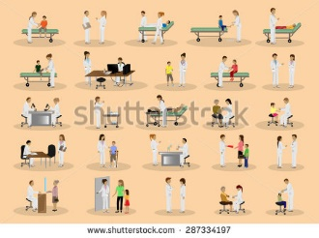
Challenges In Health Care
Overdependence on manual caretaking
Observation is only available in hospitals
Continuous observation doesn’t happen

Slide 5

Challenges In Health Care
No mechanism for proper storage for huge healthcare data.
No tracking of usage on how medicines and equipment are being used out of hospital.
Manual renewal of prescription

Slide 6
Healthcare Wish List

Slide 7


Wish 1
Unnecessary doctor visit for minor checkups

Slide 8

Wish 2
Anticipation of Patient’s condition and doctor should come when health deteriorates

Slide 9

Wish 3
Knowledge of Best medical facilities at the nearest location

Slide 10

Wish List
Automatic prescription renewal, alert for medicine expiration, check up date etc..

Slide 11

Wish 6
Prevention in billing fraud ,like
billing for unnecessary services
over-diagnosing
billing for services not rendered.
These instances needlessly charges the patient

Slide 12

Wish List
Anticipation of Patient’s condition
Unnecessary doctor visit
Knowledge of facilities
Billing fraud
Anticipation of demands
Automatic renewal

Slide 13
How Big Data Can Make Wishes Come True!

Slide 14
Hadoop And Health Care
“ Hadoop is the only technology that allows healthcare to store data in its native form. … Now we can bring everything into Hadoop, regardless of data format or speed of ingest. If I find a new data source, I can start storing it the day that I learn about it. We leave no data behind ”
Charles Boicey
Enterprise analytics architect
Stony Brook Medicine

Slide 15












Hadoop And Internet Of Things (IOT)
Health Care can become extra intelligent if big data come together with internet of things
IOT is the network of physical devices embedded with electronics, software, sensors.
Enable objects to exchange data within the existing Internet infrastructure.
Results in improved efficiency, accuracy and economic benefit.
Each device in the network is uniquely identifiable

Slide 16




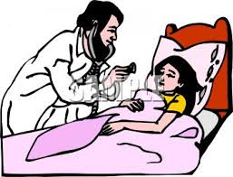
One Data Platform for All Stake holders
Hadoop makes data less expensive and more available, so that
Patients have more choices,
Doctors have more insight
Pharma and device manufacturers can deliver more effective, reliable products.

Slide 17


Hadoop Decreases Unnecessary Doctor Visit
Patients need not be in under care only in hospitals.
They can be under care even if they are indulged in their daily activities.
Patients can wear a device like watch which can send the body medical measures remotely

Slide 18

Hadoop helps in achieving Right Care
Once patient situations deteriorates doctor get’s an alert and they can directly visit the patient or they can alert the patient about their situation even before falling sick.

Slide 19



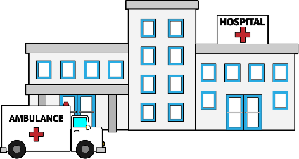

Hadoop helps in achieving Right Provider
Patients can choose the best available medical facility almost in a real time at any location using that geography’s detail available as data in the central repository.
Good
Average

Slide 20
Demo On Encryption Of Patient’s Sensitive Information

Slide 21
Demo

Slide 22

Healthcare Companies Using Big Data

Slide 23





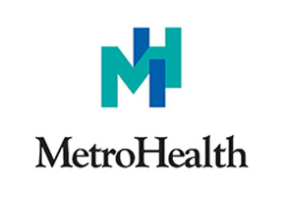


Health Care Companies using Big Data

Slide 25
Survey

